Slide 1

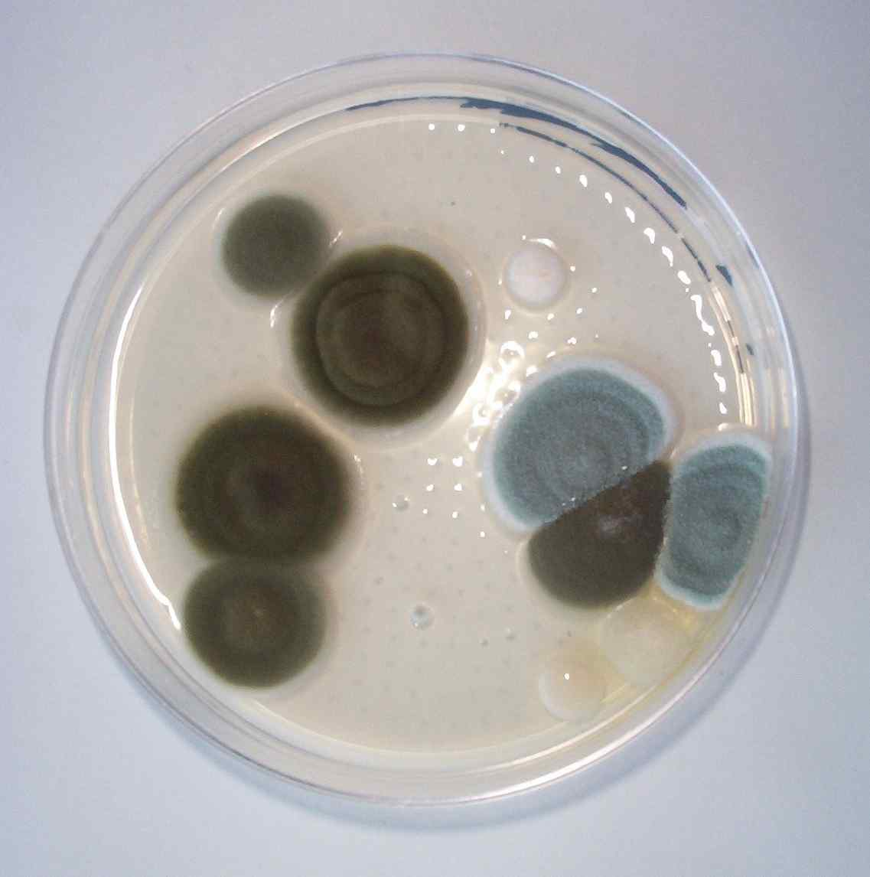
Petri

Slide 2
Today’s Agenda
Introduction
How to Play
Our Design
Our Tools
Questions and Comments

Slide 3
What is Petri?
Petri is a Mac OS X application based on the pen-and-paper game “fungus”
Two or more fungus-like organisms vie for territory control in a grid-like petri dish
Players take turns placing randomly-generated tetrominos in the dish, attempting to surround regions of the opponent’s fungus on two sides, to capture territory and
  Try to capture head
  Captures are recursive

Slide 4
Feature List
Feature List:
One to four players
Computer AI Players for single- and multiplayer games
Team games
Networked multiplayer
Hotseat multiplayer ✓
Automatic local-network server discovery with Bonjour
Animated graphics using CoreAnimation ✓
Rules variations (e.g., hexagonal game grid)
Game recording and replays
✓ — key features (to be implemented first)

Slide 5
Rules
The object of the game is to eliminate all opponents;
  When a player’s head is captured or killed.
Captures are the primary means of gaining territory in the game while kills provide a more direct means of attacking opponent:
  Cells are captured by surrounding the cell, or a straight line of cells, on two sides, horizontally, vertically, or diagonally.
  Any cells surrounded this way are given to the capturing player
  Captures are recursive: capturing a cell that would surround additional cells also captures the additional cells
  Capturing a player’s head captures all of the player’s territory.
Cells are killed when they are bitten or when they are separated from a player’s head, (either via a bite or a capture)
Killed cells are removed from the board, leaving the territory empty.
  Note that captures will occasionally result in cells being killed, since cells can be captured diagonally, but must be in contact with their owner's territory horizontally vertically to live.

Slide 6
Rules
When the player’s turn begins, he or she is given a piece
Pieces consist of arrangements of cells, and can occupy any of the following:
  one cell
  two adjacent cells
  three cells in an L-shape or straight line
  any possible tetromino region (think Tetris pieces)
  five cells in a straight line

Slide 7
Rules
Before placing the piece, if the player has any “bites,” he or she may use them to attack an opponent
Bites are accumulated over time, or can be picked up from certain, marked locations in the dish
Bites work as follows:
The player selects a cell to bite, ensuring the cell meets the following requirements:
The cell is controlled by an opponent, and
The cell is horizontally or vertically adjacent to a cell controlled by the player
  If the player has “big bites” or “monster bites,” the player may select additional cells controlled by the opponent provided the selected cells all lie in a straight line:
    Two for big bites
    Three for monster bites, provided the selected cells all lie in a straight line
Players may use any number of bites in one turn, provided they have enough, but they may not bite after they have placed their piece.

Slide 8
Rules
The player attempts to place the piece he or she has been given at a location in the dish
The player may rotate (but not flip) the piece before placing it, but the piece may only be placed at a location fitting the following requirements:
  The piece must lie entirely within the bounds of the dish, (i.e., all cells comprising the piece must correspond to a grid location)
  The piece cannot overlap any opponent’s cells, and
  At least one of the cells in the piece must be horizontally or vertically adjacent to a cell in the dish already controlled by the player
  Placed pieces are added to the player’s territory, and when the piece is placed, the player’s turn ends. If the player cannot place the piece, he or she may choose to skip his or her turn.

Slide 9
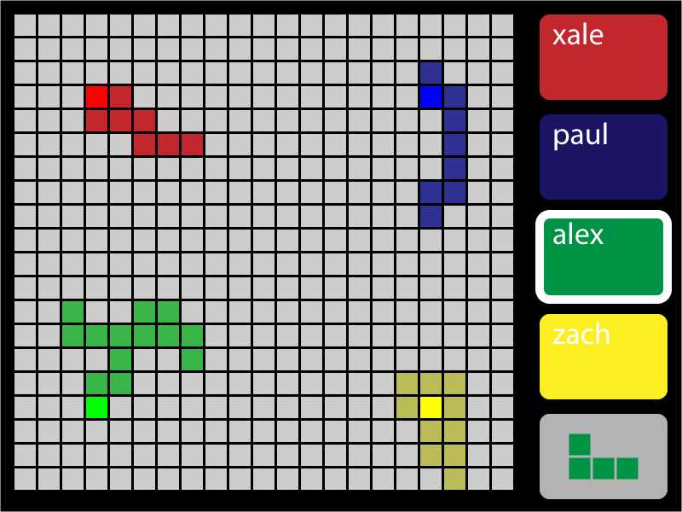
Game Interface

Slide 10
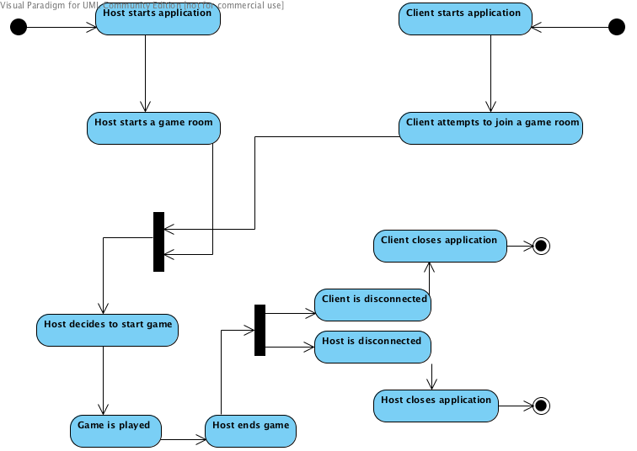
Activity Diagram of Game Architecture

Slide 11
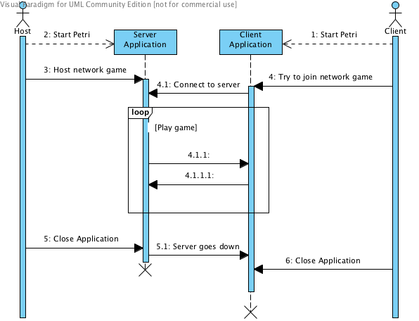
Sequence Diagram of Game Architecture

Slide 12
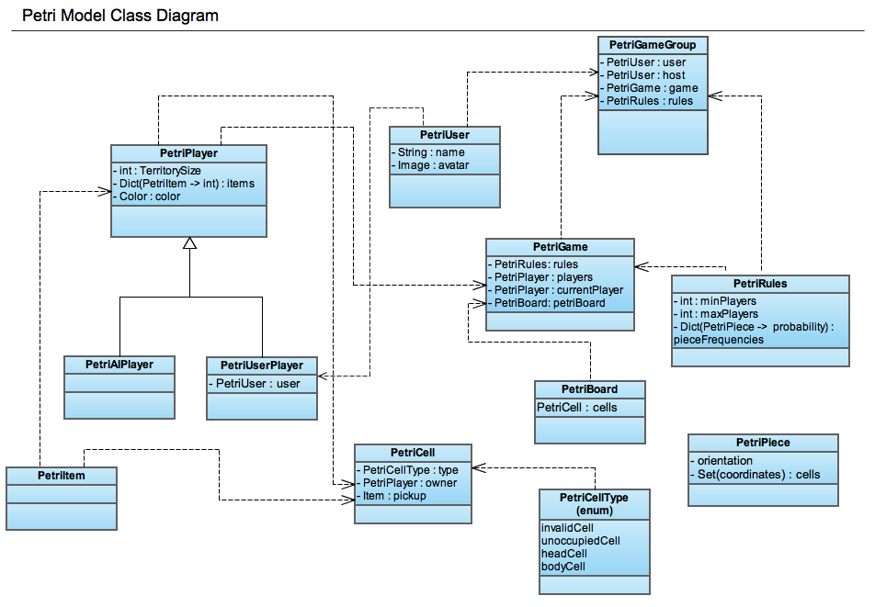
Class Diagram

Slide 13
Conclusion
Questions and Comments…

